Slide 1
3 Numerical Descriptive Measures
Business Statistics:
Communicating with Numbers, 4e
By Sanjiv Jaggia and Alison Kelly
Copyright 2022 © McGraw Hill LLC. All rights reserved. No reproduction or distribution without the prior written consent of McGraw Hill LLC.

Slide 2
Chapter 3 Learning Objectives (L Os)
L O 3.1 Calculate and interpret measures of central location.
L O 3.2 Interpret a percentile and a boxplot.
L O 3.3 Calculate and interpret a geometric mean return and an average growth rate.
L O 3.4 Calculate and interpret measures of dispersion.
L O 3.5 Explain mean-variance analysis and the Sharpe ratio.
L O 3.6 Apply Chebyshev’s theorem, the empirical rule, and z-scores.
L O 3.7 Calculate and interpret measures of association.

Slide 3
Introductory Case: Investment Decision
Dorothy works as a financial advisor at a large investment firm.
She meets with an inexperienced investor who has some questions regarding two approaches to mutual fund investing.
The investor shows Dorothy the annual return data for Fidelity’s Growth Index mutual fund (Growth) and Fidelity’s Value Index mutual fund (Value).
Year | Growth | Value
1984 | −5.50 | −8.59
1985 | 39.91 | 22.10
… | … | …
2019 | 38.42 | 31.62
Dorothy will use the sample information for the following tasks.
Calculate and interpret the typical return for these two mutual funds.
Calculate and interpret the investment risk for these two mutual funds.
Determine which mutual fund provides the greater return relative to risk.

Slide 4
3.1 Measures of Central Location 1
The term central location refers to how numerical data tend to cluster around some middle or central value.
Measures of central location attempt to find a typical or central value that describes the data.
The arithmetic mean is the primary measure of central location.
Referred to as the mean or the average.
Add up all the observations and divide by the number of observations.

Slide 5
3.1 Measures of Central Location 2
The only thing that differs between a population mean and a sample mean is the notation.
The population mean is denoted as μ.
N observations in the population: x₁, x₂, …, x_{N.}
μ is a parameter (describes a population).
The sample mean is dented as
n observations in the sample: x₁, x₂, …, x_{n}
is a statistic (describes a sample).
Can be misleading in the presence of extremely small or large observations, or outliers.

Slide 6
3.1 Measures of Central Location 3
Example: the mean return for Growth and the mean return for Value.
Growth:
Value:
Over the 36-year period, the mean return for Growth was greater than the mean return for Value.
As we will see, we would be ill-advised to invest in a mutual fund solely on the basis of its average return.

Slide 7
3.1 Measures of Central Location 4
Example: salaries of employees at Acetech.
Title | Salary
Administrative Assistant | 40,000
Research Assistant | 40,000
Data Analyst | 65,000
Senior Research Associate | 90,000
Senior Data Analyst | 100,000
Senior Sales Associate | 145,000
Chief Financial Officer | 150,000
President (and owner) | 550,000
Since these are all employees, calculate the population mean.
This value does not reflect the typical salary; 6 of the 8 employees earn less than the mean.

Slide 8
3.1 Measures of Central Location 5
Since the mean can be affected by outliers, we often calculate the median.
The median is the middle value of a variable.
It divides the data in half.
An equal number of observations lie above and below the median.
The middle value if n (or N) is odd.
The average of the two middle values if n (or N) is even.
The median is especially useful when outliers are present.
The mean and median are both typically published.
If they differ, then the variable likely contains outliers.

Slide 9
3.1 Measures of Central Location 6
Example: the median salary of Acetech employees.
Arrange the data in ascending order.
Position: | 1 | 2 | 3 | 4 | 5 | 6 | 7 | 8
Value: | 40,000 | 40,000 | 65,000 | 90,000 | 100,000 | 145,000 | 150,000 | 550,000
Since there are 8 salaries, the median is the average of the observations in the 4th and 5th positions.
The median is
Four salaries are less than $95,000 and four salaries are greater than $95,000.
Compared to the mean of $147,500, the median better reflects the typical salary.

Slide 10
3.1 Measures of Central Location 7
The mode of a variable is the observation that occurs most frequently.
There can be one or more modes, or even no mode.
One mode: unimodal.
Two modes: bimodal.
The mode is a less useful measure of centrality when there are more than three modes.
Example: modal salary for employees at Acetech
$40,000 is earned by two employees, every other salary occurs just once.
$40,000 is the mode.
Most employees earn considerably more than this.
Just because an observation occurs with the most frequency does not guarantee that it best reflects the center of the variable.

Slide 11
3.1 Measures of Central Location 8
To summarize a categorical variable, the mode is the only meaningful measure of central location.
Example: sizes of women’s sweatshirts.
S | L | L | M | S | L | M | L | L | M
The sizes are S, M, or L.
S and M appear 2 times each, L appears 5 times.
The modal size is L.

Slide 12
3.1 Measures of Central Location 9
Access the text alternative for slide images.

Slide 13
3.1 Measures of Central Location 10
Example: measures of centrality for Growth and Value.
With Excel.
Access the text alternative for slide images.

Slide 14
3.1 Measures of Central Location 11
Example: measures of centrality for Growth and Value.
With R.
> summary (myData)
Year* | Growth | Value
Min. :1984 | Min. :-40.90 | Min. :-46.520
1st Qu. :1993 | 1st Qu. : 2.86 | 1st Qu. : 1.702
Median :2002 | Median :15.24 | Median :15.380
Mean :2002 | Mean :15.76 | Mean :12.005
3rd Qu. :2011 | 3rd Qu. :36.97 | 3rd Qu. :22.348
Max. :2019 | Max. :79.48 | Max. :44.080
*Note that in this example, the summary statistics for the variable Year are not useful.

Slide 15
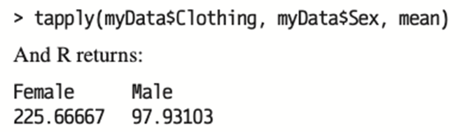
3.1 Measures of Central Location 12
It is sometimes useful to subset the observations, and compute means for each subset.
Example: mean spending by sex.
Customer | Sex | Clothing | Health | Tech | Misc
1 | Female | 246 | 185 | 64 | 75
2 | Male | 171 | 78 | 345 | 10
… | … | … | … | … | …
130 | Male | 52 | 73 | 542 | 58
With Excel:
Sex | Clothing | Health | Tech | Misc
Female | 225.67 | 100.25 | 47.10 | 159.88
Male | 97.93 | 100.64 | 310.97 | 85.84
With R:
Access the text alternative for slide images.

Slide 16
3.1 Measures of Central Location 13
So far each observation of a variable contributed equally to the mean.
The weighted mean is relevant when some observations contribute more than others.
Let w₁, w₂, ...., w_{n} denote the weight of sample observations x₁, x₂, ...., x_{n} such that w₁ + w₂ + .... + w_{n} = 1.
The weighted mean is computed as
For a frequency distribution, we substitute the relative frequencies for w _{i} and the midpoint of each interval for x _{i}.
The weighted mean for the population is computed similarly.

Slide 17
3.1 Measures of Central Location 14
Example: a student scores 60 on Exam 1, 70 on Exam 2, and 80 on Exam 3. What is the student’s average score for the course if Exams 1, 2, and 3 are worth 25%, 25%, and 50% of the grade, respectively?
Let w₁ = 0.25, w₂ =0.25, w₃ = 0.50
The average score is the weighted mean.
Note the unweighted mean is only 70.

Slide 18
3.1 Measures of Central Location 15
A distribution is symmetric if one side of the histogram is a mirror image of the other.
For a symmetric symmetric and unimodal distribution, the mean, median, and mode are equal.
Positively skewed: mean is usually greater than the median.
Negatively skewed: the mean is usually less than the median.
The skewness coefficient is a measure of skewness.
Zero: observations are evenly distributed on both sides of the mean (symmetric).
Positive: extreme observations in the right tail, pulling the mean up relative to the median.
Negative: extreme observations in the left tail, pulling the mean down relative the median.

Slide 19
3.2 Percentiles and Boxplots 1
A percentile divides the data into two parts.
Approximately p percent of the observations are less than the
Approximately 1 − p percent of the observations are greater than the
A percentile is a measure of location.
It is also used as a measure of relative position because it is easy to interpret.

Slide 20
3.2 Percentiles and Boxplots 2
When we calculate the 25th, 50th, and 75th percentiles for a variable, we have divided it into four equal parts or quarter.
25th percentile: Q1.
50th percentile: Q2.
75th percentile: Q3.
It only makes sense to calculate percentile for larger data sets.
Rely on Excel and R to compute these.
Different algorithms so the values might be slightly different.
With larger sample size, the differences tend to be negligible.
A five-number summary is commonly reported: the minimum, quartiles, and the maximum.
Note IQR = Q3 − Q1: range of the middle 50% of values.

Slide 21
3.2 Percentiles and Boxplots 3
Example: five-number summary for the Growth and Value variables.
With Excel:
 | Min | Q1 | Q2 | Q3 | Max
Growth | −40.90 | 2.86 | 15.25 | 36.97 | 79.48
Value | −46.52 | 1.70 | 15.38 | 22.44 | 44.08
With R:
> summary(myData)
Year* | Growth | Value
Min. :1984 | Min. :-40.90 | Min. :-46.520
1st Qu. :1993 | 1st Qu. : 2.86 | 1st Qu. : 1.702
Median :2002 | Median :15.24 | Median :15.380
Mean :2002 | Mean :15.76 | Mean :12.005
3rd Qu. :2011 | 3rd Qu. :36.97 | 3rd Qu. :22.348
Max. :2019 | Max. :79.48 | Max. :44.080
*Note that in this example, the summary statistics for the variable Year are not useful.

Slide 22
3.2 Percentiles and Boxplots 4
A boxplot, also referred to as a box-and-whisker plot, is a way to graphically display a five-number summary.
a. Plot the five-number summary values in ascending order on the horizontal axis.
b. Draw a box encompassing the first and third quartiles.
c. Draw a dashed vertical line in the box at the median.
d. Draw a line (“whisker”) that extends from Q1 to the minimum value that is not further from 1.5*IQR from Q1 (similarly for the other side).
e. Use an asterisk (or another symbol) to indicate observations that are farther than 1.5*IQR from the box (outliers).
Access the text alternative for slide images.

Slide 23
3.2 Percentiles and Boxplots 5
A boxplot is used to informally gauge the shape of the distribution.
Symmetry: median is in the center of the box, and the left and right whiskers are equally distant from their respective quartiles.
Positively skewed: median is left of center and the right whisker is longer than the left whisker.
Negatively skewed: median is right of center and the left whisker is longer than the right whisker.
If outliers exist, we need to include them when comparing the length of the whiskers.
Excel does not provide a simple and straightforward way to construct a boxplot.
R and other statistical packages offer this option.

Slide 24
3.2 Percentiles and Boxplots 6
Example: using the five-number summaries for Growth and Value.
 | Min | Q1 | Q2 | Q3 | Max
Growth | −40.90 | 2.86 | 15.25 | 36.97 | 79.48
Value | −46.52 | 1.70 | 15.38 | 22.44 | 44.08
Find the IQR for Growth.
Determine whether any outliers exist.
Repeat for Value.
Is the distribution for Growth symmetric?
If not, comment on its skewness.
Repeat for value.
Use R to construct boxplots for Growth and Value.
Are the results consistent with the previous parts?

Slide 25
3.2 Percentiles and Boxplots 7
Growth;
IQR = Q3 − Q1 = 36.94 − 2.86 = 34.11.
Limit = 1.5 × IQR = 1.5 × 34.11 = 51.17.
Q1− Min = 2.86 − (− 40.90) = 43.76 (left whisker).
Max − Q3 = 79.48 − 36.94 = 42.51 (right whisker).
Both are less than 51.17, no outliers.
Value:
IQR = Q3 − Q1 = 22.44 − 1.70 = 20.74.
Limit = 1.5 × IQR = 1.5 × 20.74 = 31.11.
Q1 − Min = 1.70 − (− 46.52) = 48.22 (left whisker).
Max − Q3 = 44.08 − 22.44 = 21.64 (right whisker).
Left whisker limit exceeds the limit, there is an outlier(s) on the left side.

Slide 26
3.2 Percentiles and Boxplots 8
Growth:
Median − Q1 = 15.25 − 2.86 = 12.39.
Q3 − Median = 36.97 − 15.25 = 21.72.
Since 12.39 < 21.72, the median is left of center.
Left whisker is longer than the right whisker.
Skewness coefficient is negative.
The distribution is negatively skewed.
Value (similar calculations):
Median falls right of center.
Left whisker is longer than the right whisker.
Skewness coefficient is negative.
The distribution is negatively skewed.

Slide 27
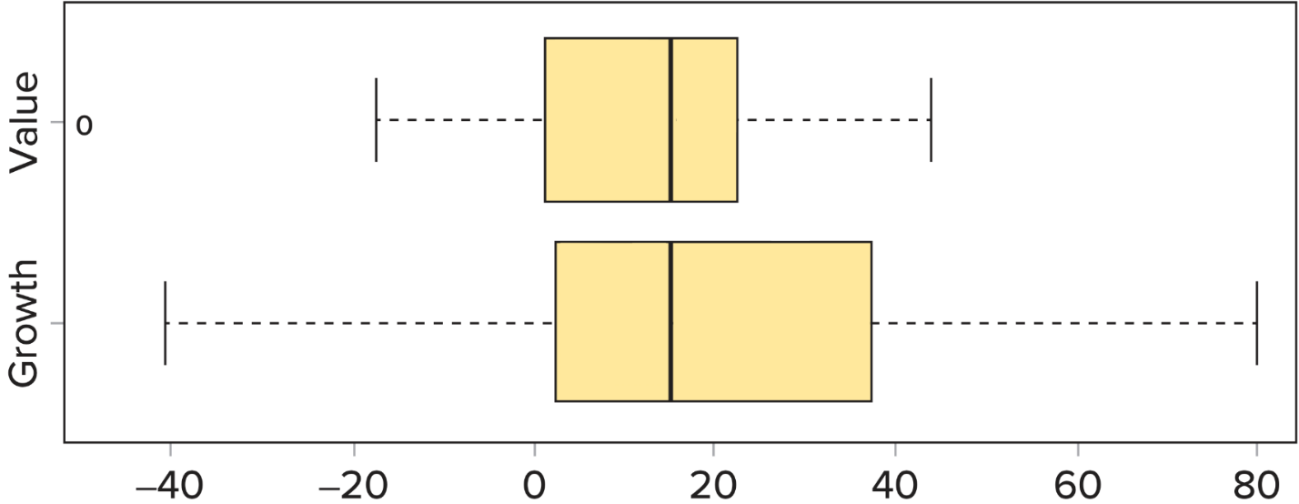
3.2 Percentiles and Boxplots 9
Boxplot with R.
Annual Returns, 19 84 to 20 19 (in percent)
Access the text alternative for slide images.

Slide 28
3.3 The Geometric Mean 1
The arithmetic mean is additive.
Ignores the effects of compounding.
Suitable for analyzing a one-year investment.
The geometric mean is a multiplicative average.
Smaller than the arithmetic mean.
Less sensitive to outliers.
The geometric mean is:
Relevant measure when evaluating investment returns over several years.
Calculating the average growth rates.
For n multiperiod returns R₁, R₂, …, R₃, the geometric mean return G_{R} is given by the below.

Slide 29
3.3 The Geometric Mean 2
Example: given an initial investment of $1,000 over two years.
Year | Return % | Value at the End of Year
1 | 10 | 1,000 + 1,000 × 0.10 = 1,100
2 | −10 | 1,000 + 1,000 × (−0.10) = 990
The arithmetic mean return is
The geometric mean is
We can interpret the geometric return as the annualized return from the two year-period.
Year | Annualized Return | Value at the End of Year
1 | −0.5 | 1,000 + 1,000 × (−0.005) = 995
2 | −0.5 | 995 + 995 × (−0.005) = 990

Slide 30
3.3 The Geometric Mean 3
Also use the geometric mean when we calculate an average growth rate.
For n growth rates g₁, g₂, …, g_{n}, the average growth rate is computed as
There is a simpler way to compute the average growth rate from the values rather than growth rates.
For n observations x₁, x₂, …, x_{n}, the average growth rate is computed using n−1 distinct growth rates.

Slide 31
3.3 The Geometric Mean 4
Example: sales for multinational corporation
Year | 1 | 2 | 3 | 4 | 5
Sales | 13,322 | 14,883 | 14,203 | 14,534 | 16,915
The growth rate after five years is 6.15%.

Slide 32
3.4 Measures of Dispersion 1
Measures of central location do not describe the underlying dispersion.
Measures of dispersion gauge the variability of a variable.
0 indicates all the observations are identical.
Increases as the observations become more diverse.
The range is the simplest measure.
Difference between the maximum and minimum.
Range = Max − Min
Not good because it focuses solely on extreme observations.
The interquartile range (I Q R) is the difference between the third quartile and the first quartile.
I Q R = Q₃ − Q₁
The range of the middle 50% of the variable
Does not depend on the extreme observations
Neither the range or IQR incorporate all the observations.

Slide 33
3.4 Measures of Dispersion 2
A good measure of dispersion should consider differences of all observations from the mean.
If we average all the differences from the mean, the positives and negatives will cancel out.
The mean absolute difference (MAD) is the average of the absolute differences between the observations and the mean.
For sample observations x₁, x₂, ...., x_{n} , the sample MAD is computed as sample MAD =
For population observations x₁, x₂, ...., x_{N} , the population MAD is computed as population MAD =

Slide 34
3.4 Measures of Dispersion 3
The variance and the standard deviation are the two most widely used measures of dispersion.
Compute the average of the squared differences.
The squaring of the differences emphasizes larger differences.
The variance is defined as the average of the squared differences between the observations and the mean.
Whatever the units of original variable, the variance has squared units.
To return to the original units, we take the positive square root of the variance which gives the standard deviation.

Slide 35
3.4 Measures of Dispersion 4
For sample observations x₁, x₂, ...., x_{n}, the sample variance
and standard deviation s are:
​
​
For population observations x₁, x₂, ...., x_{N}, the population variance
and standard deviation σ are:
​
​
The sample variance uses n − 1 rather than n in the denominator to ensure the sample variance is an unbiased estimator (Appendix 7.2).

Slide 36
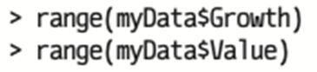
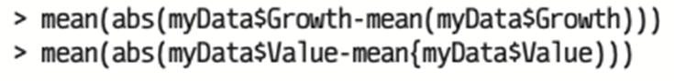
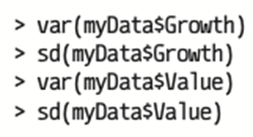
3.4 Measures of Dispersion 5
Summary of Excel and R Commands.
Range:
Excel: MAX – MIN
R:
MAD;
Excel: AVEDEF
R:
Standard deviation and variance:
Excel: VAR.S and STDEV.S
R:
Access the text alternative for slide images.

Slide 37
3.4 Measures of Dispersion 6
Example: measures of dispersion for Growth and Value.
Range:
Growth: 120.38.
Value: 90.6.
MAD:
Growth: 17.49.
Value: 13.67.
Variance and standard deviation:
Growth: 566.41, 23.80.
Value: 323.25, 17.98.

Slide 38
3.4 Measures of Dispersion 7
We want to compare the variability of two or more data sets that have different means or units.
The coefficient of variation is the relevant measure.
Denoted C V.
Adjusts for differences in the magnitudes of the means.
Unitless, allowing easy comparisons of mean-adjusted dispersion across different data sets.
Sample C V:
Population C V:

Slide 39
3.4 Measures of Dispersion 8
Example: C V for Growth and Value
Growth C V:
Value C V:
The coefficient of variation indicates that the relative dispersion of the two variables is about the same.

Slide 40
3.5 Mean-Variance Analysis and the Sharpe Ratio 1
Investments include financial assets such as stocks, bonds, and mutual funds.
The average return represents an investor’s reward, whereas variance, or equivalently standard deviation, corresponds to risk.
Mean-variance analysis postulates the performance of an asset is measured by its rate of return, evaluated in terms of reward (mean) and risk (variance).
Investments with higher returns also carry higher risk.

Slide 41
3.5 Mean-Variance Analysis and the Sharpe Ratio 2
The Sharpe ratio is the “reward-to-variability” ratio.
Characterizes how well the return compensates for the risk.
Measures the extra reward per unit of risk.
Calculated as
where R _{i} is the mean return for a risk-free asset such as a Treasure bill (T-bill).
The numerator measures the extra reward for the added risk, the difference is excess return.
The higher Sharpe ratio, the better the investment compensates its investors for risk.

Slide 42
3.5 Mean-Variance Analysis and the Sharpe Ratio 3
Example: compute the Sharpe ratios for the Growth and Value fund assuming
Growth :
Value:
The Growth funds have a higher rate of return (good) along with a higher variance (bad).
Growth funds offer more reward per unit risk than the Value funds.

Slide 43
3.6 Analysis of Relative Location 1
The mean and standard deviation alone don’t tell us about relative location.
Low standard deviation: observations are close to the mean.
High standard deviation: observations are spread out.
Chebyshev’s Theorem.
The proportion of observations that lie within k standard deviations from the mean is at least
where k is any number greater than 1.
At least 75% of the observations fall within 2 standard deviations from the mean.
At least 89% of the observations fall within 3 standard deviations from the mean.
Applies to all variables, regardless of the shape of the distribution.
Conservative bounds for the percentage of observations falling into interval.

Slide 44
3.6 Analysis of Relative Location 2
Example: a large lecture class has 280 students.
The mean score on an exam is 74 with a standard deviation of 8.
At least how many students scored within 58 and 90?
58 and 90 are two standard deviations below and above the mean.
58 = 74 − 2 × 8.
90 = 74 + 2 × 8.
At least 75% of the scores will fall within 58 and 90.
At least 75% of 280 students, or 210 students, scored within 58 and 90.

Slide 45
3.6 Analysis of Relative Location 3
Chebyshev’s Theorem gives a conservative bound, the empirical rule makes more precise statements.
Assume the observations are drawn from a relatively symmetric and bell-shaped distribution.
Inspection of a histogram.
Other numerical measures (for example, skewness).
The empirical rule provides the approximate percentage of observations that fall within a specified number of standard deviations from the mean.
Approximately 68% of all observations fall in the interval
Approximately 95% of all observations fall in the interval
Almost all all observations fall in the interval
If the distribution is symmetric and bell-shaped, the empirical rule is preferable to Chebyshev’s Theorem.

Slide 46
3.6 Analysis of Relative Location 4
Access the text alternative for slide images.

Slide 47
3.6 Analysis of Relative Location 5
Example: a large lecture class has 280 students.
The mean score on an exam is 74 with a standard deviation of 8.
Approximately how many students scored within 58 and 90?
Approximately how many students scored more than 90?
58 and 90 are two standard deviations below and above the mean.
So about 95% of 280 students, or 266, scored within 58 and 90.
90 is two standard deviations above the mean.
95% of the observations fall within two standard deviations of the mean, 5% fall outside the interval.
Given the symmetry of the distribution, 2.5% scored above 90.
2.5% of the 280 students, or about 7, scored above 90 on the exam.

Slide 48
3.6 Analysis of Relative Location 6
Use the mean and the standard deviation to find the relative location of an observation within a distribution.
The z-score gives the relative position of an observation within a distribution by
Unitless measure.
Measures the distance of an observation from the mean in terms of standard deviations.
Also called standardizing.

Slide 49
3.6 Analysis of Relative Location 7
If the distribution is relatively symmetric and bell-shaped, use z-scores to detect outliers.
Since almost all observations are within three standard deviations of the mean, an observation is an outlier if its z‑score is more than 3 or less than −3.
Such observations must be reviewed to determine if they should remain in the data set.

Slide 50
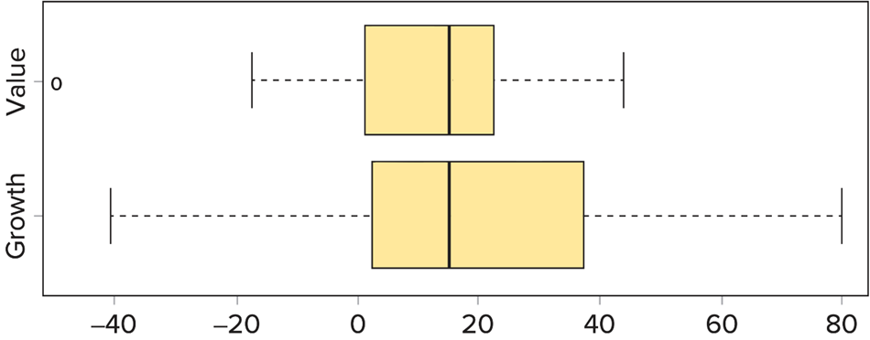
3.6 Analysis of Relative Location 8
Example: compute the z-scores of the smallest and largest observations in Growth, and determine if they are outliers.
Smallest:
Largest:
Neither are outliers, which is consistent with the Growth’s boxplot.
Annual Returns, 19 84 to 20 19 (in percent)
Access the text alternative for slide images.

Slide 51
3.7 Measure of Association 1
In Chapter 2, we used a scatterplot to visually assess whether two variables had some type of linear relationship.
If the relationship is linear, there are two numerical measures of association that quantify the direction and strength of the linear relationship.
Covariance measures the direction of the linear relationship.
Population:
Sample:
Negative: negative linear relationship.
Positive: positive linear relationship.
Zero: no linear relationship.
Covariance is hard to interpret because it is sensitive to the units of measurement. We cannot comment on the strength of the linear relationship.

Slide 52
3.7 Measure of Association 2
The correlation coefficient describes both the direction and strength of the linear relationship between x and y.
Population:
Sample:
Negative: negative linear relationship.
Positive: positive linear relationship.
Zero: no linear relationship.
The correlation is unit-free.
The correlation is between −1 and 1.
Correlation is − 1: perfect negative linear relationship.
Correlation is 0: not linearly related.
Correlation is 1: perfect positive linear relationship.

Slide 53
3.7 Measure of Association 3
Example: using Excel or R, find the covariance and the correlation coefficient for Growth and Value.
Access the text alternative for slide images.

Slide 54
3.7 Measure of Association 4
With Excel:
COVARIANCE.S.
CORREL.
With R:
> cov(myData)
> cor(myData)
 | Year | Growth | Value
Year | 1.00000000 | −0.02985209 | −0.02122542
Growth | −0.02985209 | 1.00000000 | 0.66747118
Value | −0.02122542 | 0.66747118 | 1.00000000

Slide 55
End of Main Content
Copyright 2022 © McGraw Hill LLC. All rights reserved. No reproduction or distribution without the prior written consent of McGraw Hill LLC.

Slide 56
Accessibility Content: Text Alternatives for Images

Slide 57
3.1 Measures of Central Location 9 – Text Alternative 1
Return to parent-slide containing images.
Table shows three-line heading of Descriptive Measure, Excel, and R. Each heading spans one column, and three will be listed side by side spanning three columns of the table. In first column, Descriptive Measure is selected. Descriptive Measure is further subcategorized into Location, Dispersion, Shape, and Association. Under each subcategory is a blank row that vertically separates each subcategory. In second column, Excel is selected. In third column, R is selected. In first column, rows second to eighth belong to the subcategory of Location under Descriptive Measure. The Location names, from top to bottom, are as follows. Mean, Median, Mode, Minimum, Maximum, Percentile, and Multiple Measures. In first column, rows eleventh to fourteenth belong to the subcategory of Dispersion under Descriptive Measure. The Dispersion names, from top to bottom, are as follows. Range, mean Absolute Deviation, Sample Variance, and Sample Standard Deviation. In first column, rows seventeenth and eighteenth belong to the subcategory of Shape. The Shape names, from top to bottom, are as follows. Skewness, and Kurtosis. In first column, rows twenty-first and twenty-second belong to the subcategory of Association under Descriptive Measure. The Association names, from top to bottom, are as follows. Sample Covariance, and Correlation. In second column, rows second to eighth, eleventh to fourteenth, seventeenth and eighteenth, and twenty-first and twenty-second belong to Excel.
Advance to rest of text alternative.

Slide 58
3.1 Measures of Central Location 9 – Text Alternative 2
Return to parent-slide containing images.
On rows second to eighth are selected, from top to bottom, =AVERAGE(array), =MEDIAN(array), =MODE(array), =MIN(array), =MAX(array), =PERCENTILE.INC(array, p)c, and NA. On rows eleventh to fourteenth are selected, from top to bottom, =MAX(array)-MIN(array), =AVEDEV(array), =VAR.S(array), and =STDEV(array). On rows seventeenth and eighteenth are selected, from top to bottom, =SKEW(array), and =KURT(array). On rows twenty-first and twenty-second are selected, from top to bottom, =COVARIANCE.S(array1, array2), and =CORREL(array1, array2). In third column, rows second to eighth, eleventh to fourteenth, seventeenth and eighteenth, and twenty-first and twenty-second belong to R. On rows second to eighth are selected, from top to bottom, mean(df$var)a, median(df$var), NAb, min(df$var), max(df$var), quantile(df$var, p)c, and summary(df). On rows eleventh to fourteenth are selected, from top to bottom, range(df$var)d, mad(df$var)e, car(df$var), and sd(df$var). On rows seventeenth and eighteenth are selected, from top to bottom, NA, and NA. On rows twenty-first and twenty-second are selected, from top to bottom, cov(df), and cor(df).
Return to parent-slide containing images.

Slide 59
3.1 Measures of Central Location 10 – Text Alternative
Return to parent-slide containing images.
Table shows two-line heading of Growth, and Value. Each heading spans two columns, and four will be listed side by side spanning four columns of the table. In first and second columns, Growth is selected. In third, and fourth columns, Value is selected. In first column, on rows first to thirteenth, from top to bottom, are listed Mean, Standard Error, Median, Mode, Standard Deviation, Sample Variance, Kurtosis, Skewness, Range, Minimum, Maximum, Sum, and Count. In second column, on rows first to thirteenth, from top to bottom, are entered 15.755, 3.966547567, 15.245, #N/A, 23.7992854, 566.4059857, 0.973702537, -0.028949752, 120.38, -40.9, 79.48, 567.18, and 36. In third column, on rows first to thirteenth, from top to bottom, are listed Mean, Standard Error, Median, Mode, Standard Deviation, Sample Variance, Kurtosis, Skewness, Range, Minimum, Maximum, Sum, and Count. In fourth column, on rows first to thirteenth, from top to bottom, are entered 12.005, 2.996531209, 15.38, #N/A, 17.97918725, 323.2511743, 1.853350762, -1.023591081, 90.6, -46.52, 44.08, 432.18, and 36.
Return to parent-slide containing images.

Slide 60
3.1 Measures of Central Location 12 – Text Alternative
Return to parent-slide containing images.
The image shows a program code for r.
Line 1: right angle bracket t apply (my Data $ Clothing, my Data $ Sex, mean)
Line 2: And R returns:
Line 3: Female 225.66667 Male 97.93103
Return to parent-slide containing images.

Slide 61
3.2 Percentiles and Boxplots 4 – Text Alternative
Return to parent-slide containing images.
The left end of the left whisker is the minimum. The left of the box is the first quartile. The vertical line in the box is the median. The right side of the box is the third quartile. The largest value is the maximum, which in this case is shown as a dot because it is an outlier. An outlier is any value that exceeds 1.5 times IQR above the third quartile or below the first quartile.
Return to parent-slide containing images.

Slide 62
3.2 Percentiles and Boxplots 9 – Text Alternative
Return to parent-slide containing images.
The first image shows, Right angle bracket boxplot (myData $ Growth, myData $ Value, main = open quotes Boxplots for Growth and Value close quotes, xlab = open quotes Annual Returns, 1984 hyphen 2019 (in percent) close quotes, names = c (open quotes Growth close quotes, open quotes Value close quotes), horizontal = TRUE, col = open quotes gold close quotes).
The second image shows, Both boxplots have medians of about 15. Q 1 for value is at 0 and for growth at 2. Q 3 for value is at 20 and for growth at 38. The maximum of growth is about 80 and the maximum of the value boxplot is about 42. The minimum of growth is about negative 40 and the minimum of the value boxplot is about negative 20.
Return to parent-slide containing images.

Slide 63
3.4 Measures of Dispersion 5 – Text Alternative
Return to parent-slide containing images.
The second image shows, The R code reads:
right angle bracket mean (abs (myData $ Growth hyphen mean (myData $ Growth)))
right angle bracket mean(abs (myData $ Value hyphen mean(myData $ Value)))
The third image shows, The R code reads:
right angle bracket var (myData $ Growth)
right angle bracket sd (myData $ Growth)
right angle bracket var (myData $ Value)
right angle bracket sd (myData $ Value)
Return to parent-slide containing images.

Slide 64
3.6 Analysis of Relative Location 4 – Text Alternative
Return to parent-slide containing images.
This graph shows that about 68% of observations fall within 1 standard deviation of the mean. About 95% of observations fall within 2 standard deviations of the mean, and almost 100% of observations fall within 3 standard deviations of the mean.
Return to parent-slide containing images.

Slide 65
3.6 Analysis of Relative Location 8 – Text Alternative
Return to parent-slide containing images.
Both boxplots have medians of about 15. Q 1 for value is at 0 and for growth at 2. Q 3 for value is at 20 and for growth at 38. The maximum of growth is about 80 and the maximum of the value boxplot is about 42. The minimum of growth is about negative 40 and the minimum of the value boxplot is about negative 20.
Return to parent-slide containing images.

Slide 66
3.7 Measure of Association 3 – Text Alternative
Return to parent-slide containing images.
The relationship between growth and value is positive and fairly linear. Most of the points are in quadrant 1, but one point is in quadrant 3.
Return to parent-slide containing images.

